Slide 1
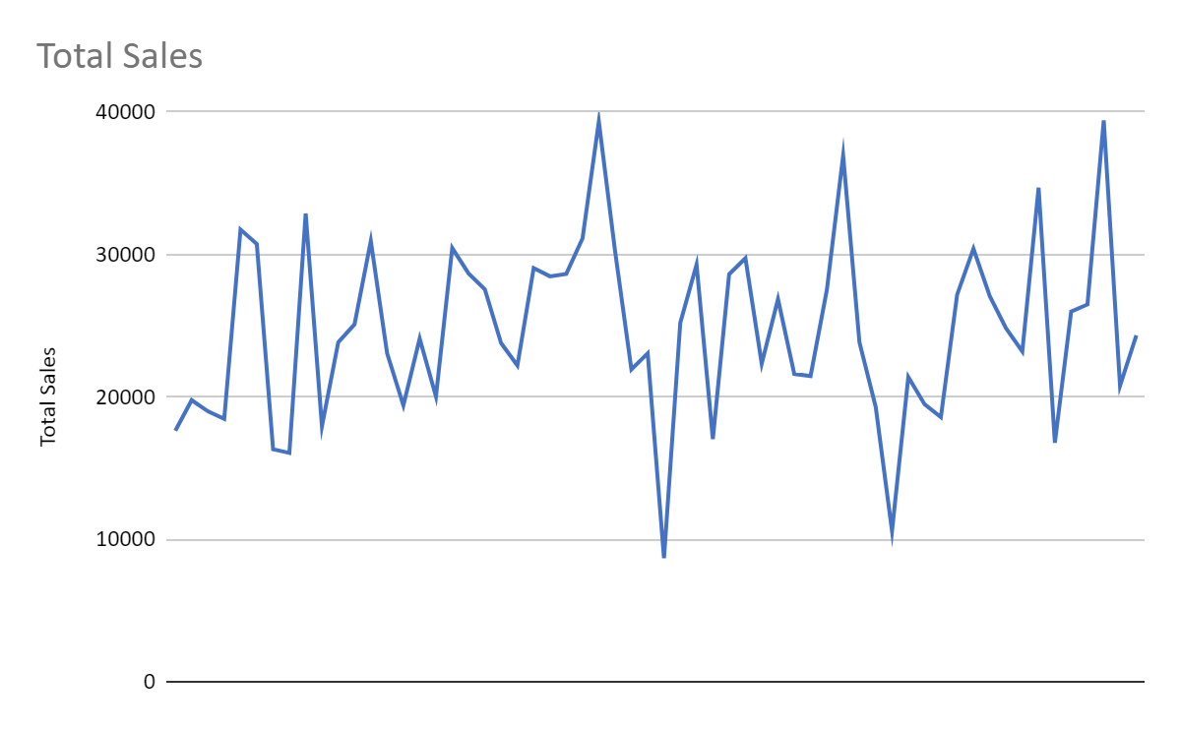
Data Analysis: Red Bull Account Sales

Slide 2
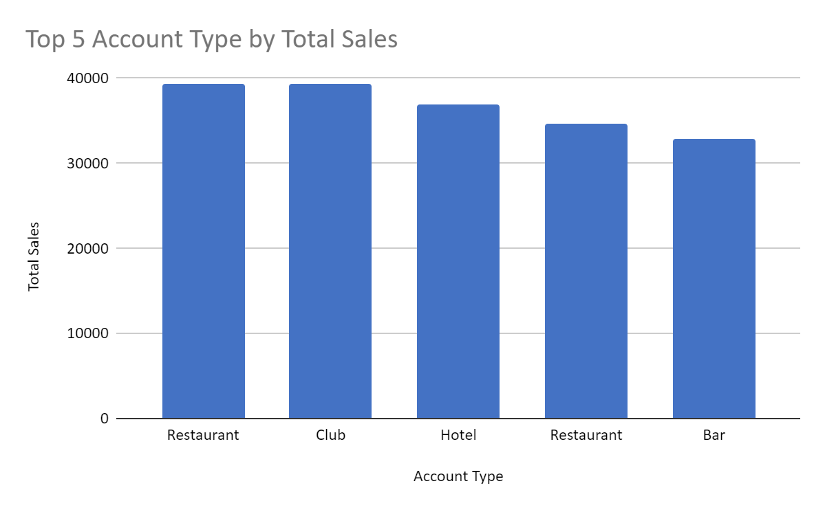
Sales Growth by Account and Account Type
Graph(s) of trends and data for sales by account and / or account type

Slide 3
Best and Worst Performing Accounts by Account Type (5 Year CAGR)
Top 2 Accounts
Bar | Restaurant | Club | Event Venue
Bar 13 | Restaurant 5 | Nightclub 2 | Event Venue 11
Bar 14 | Restaurant 12 | Nightclub 10 | Event Venue 2
Bar | Restaurant | Club | Event Venue
Bar 13
Bar 14
Bottom 2 Accounts
Bar | Restaurant | Club | Event Venue
Bar 7 | Restaurant 8 | Nightclub 11 | Event Venue 1
Bar 15 | Restaurant 11 | Nightclub 8 | Event Venue 4

Slide 4
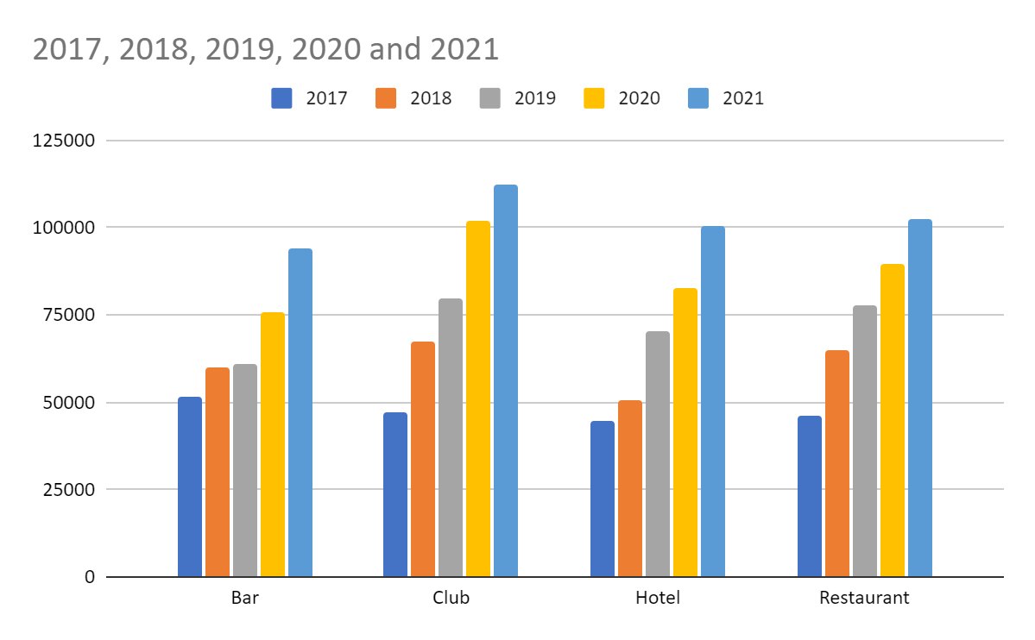
Total Sales by Account Type and Year
Graph(s) of trends and data for total sales by account type and year…

Slide 5
Observations and Key Takeaways
Write your observations and insights about sales, sales growth, marketing and promotion effectiveness, or any other takeaways here….
224.17% is highest CAGR value
Restaurant and Clubs have most sales.

